Slide 1
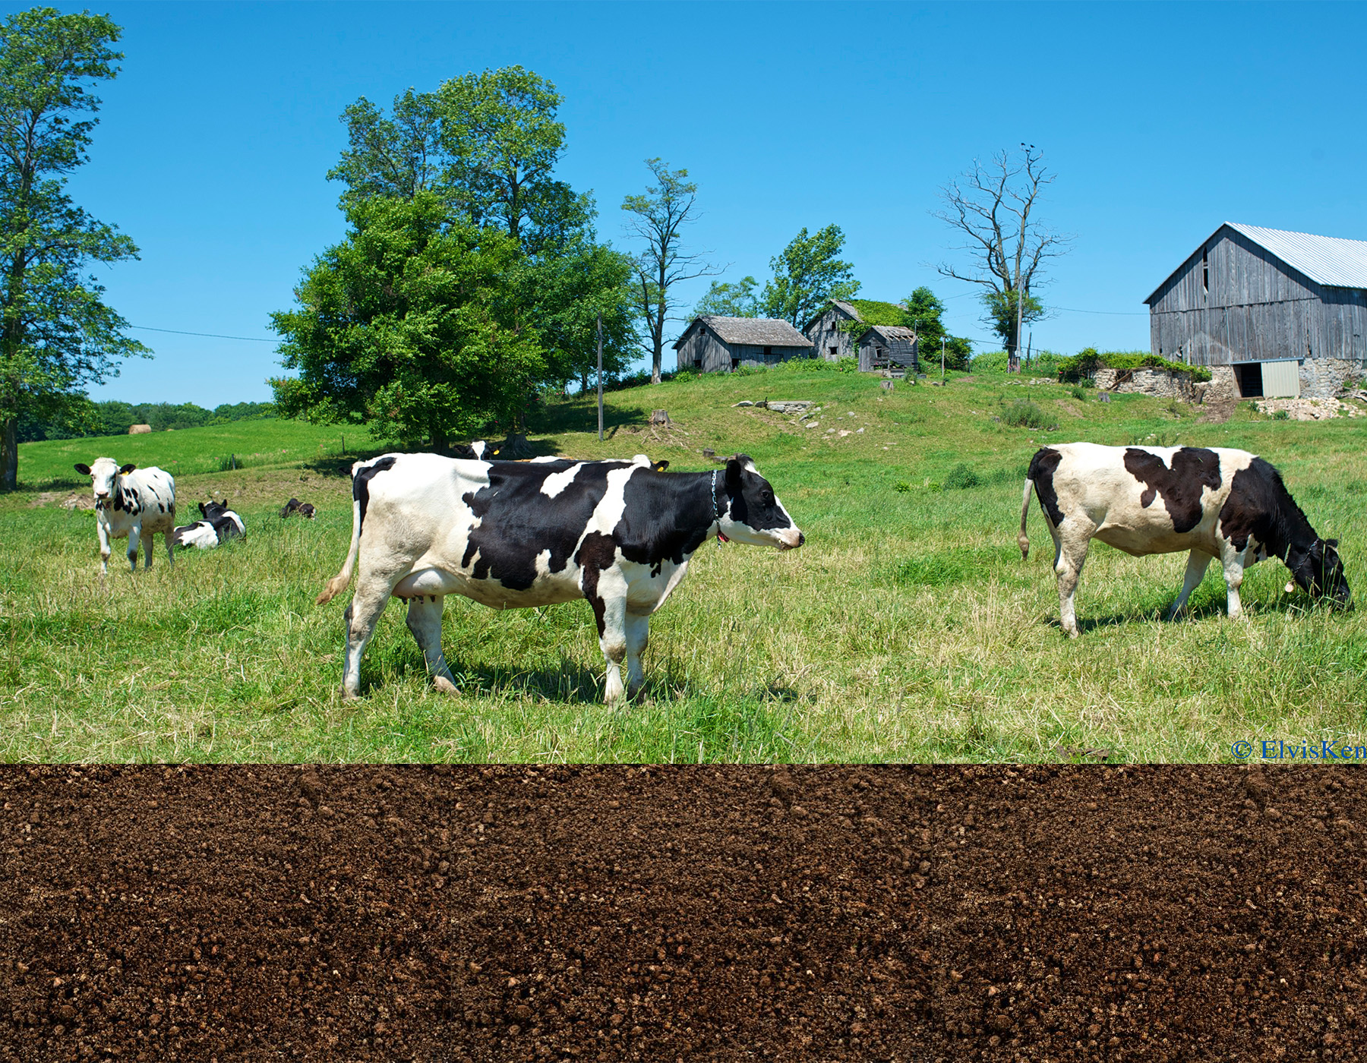
The Nitrogen Cycle
Atmospheric Nitrogen (N₂)
Nitrous Oxide(N₂O)
Greenhouse Gas
Emitted by livestock waste, industry & fuel combustion
Animals
Plants
Plant and animal waste
Assimilation
(uptake by plants)
Nitrogen fixing bacteria in soil and roots of legumes
Decomposers
(bacteria and fungi)
Nitrates (NO₃⁺)
Denitrifying Bacteria
Ammonification
Nitrifying Bacteria
Ammonium (NH₄⁺)
Nitrites (NO₂⁻)
Nitrification

