Slide 1
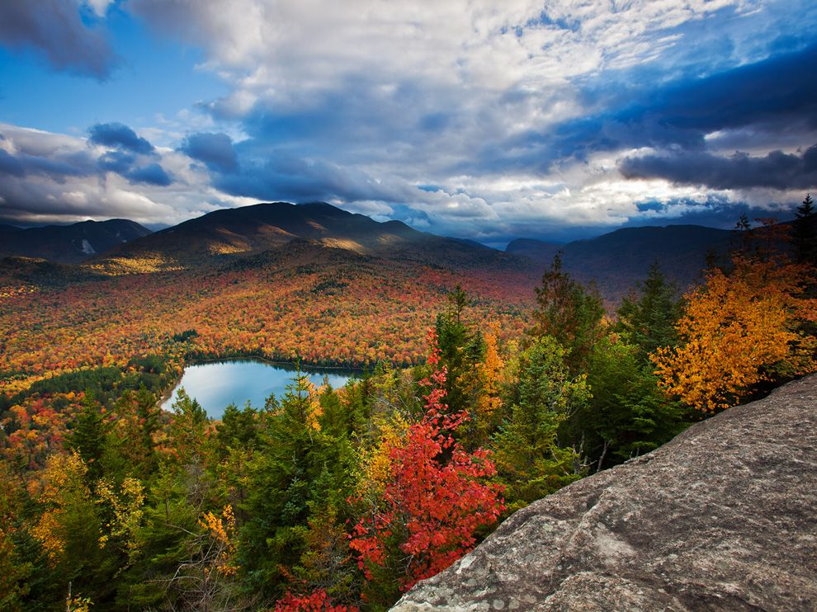
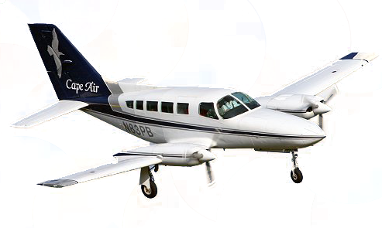
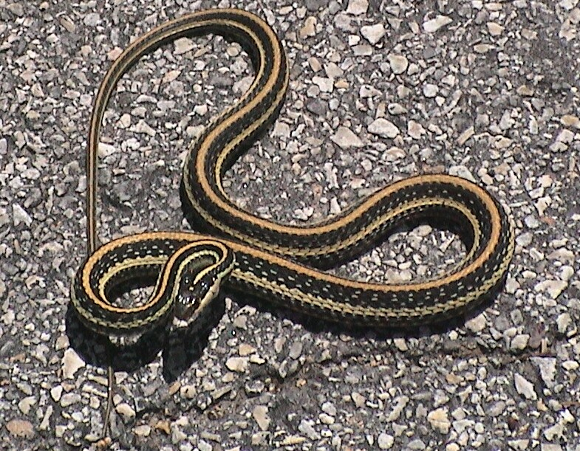
Carbon Cycle
CO₂ in air
and
dissolved in water
Combustion
(planes, trains, automobiles)
Fossilization
(peat)
Photosynthesis
Respiration by plants,
animal, fungi, etc.
Decomposition
(fungi, soil microbes)
Weatherization

