Slide 1
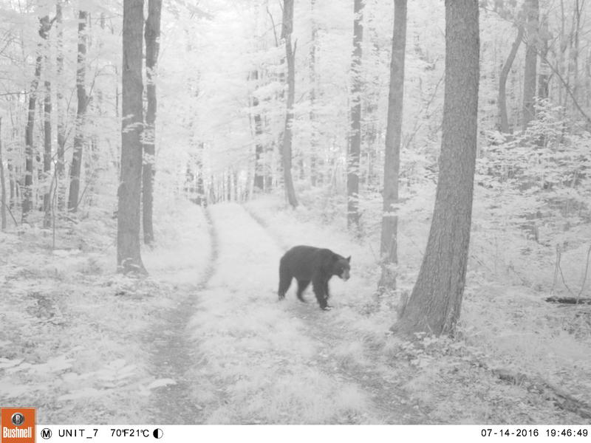

Community Camera Trapping Network
Beta test training

Slide 2
Welcome!
Outline
Introductions
What is North Country Wild?
Workflow overview
Camera deployment
Data upload

Slide 3
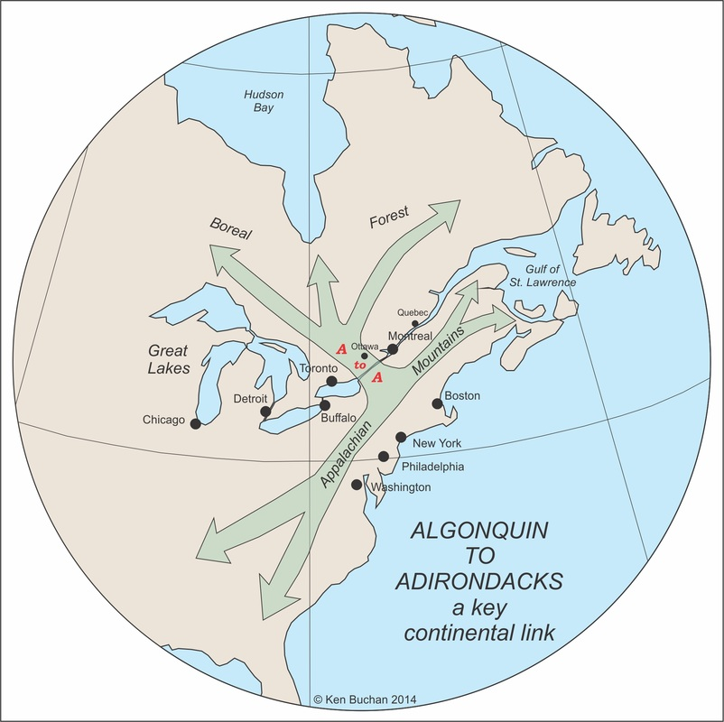
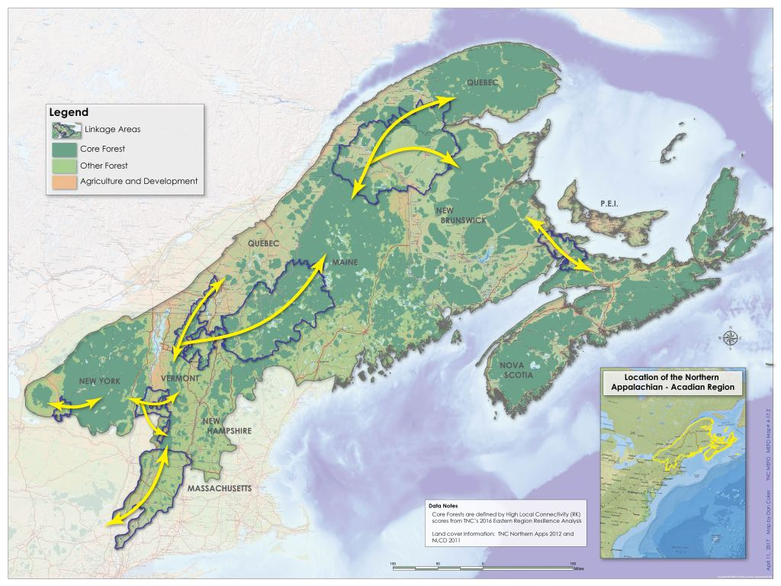
Overview of A2A
Algonquin to Adirondacks Collaborative

Slide 4
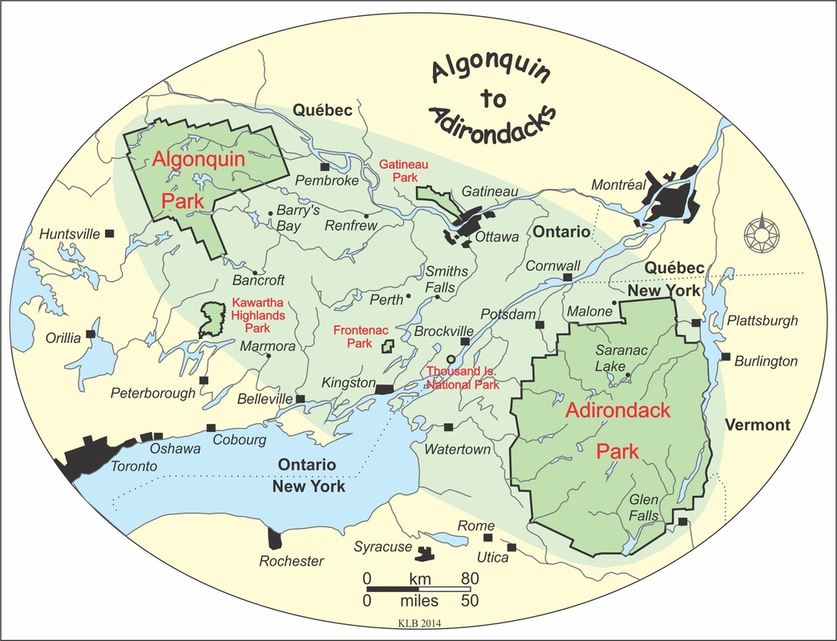
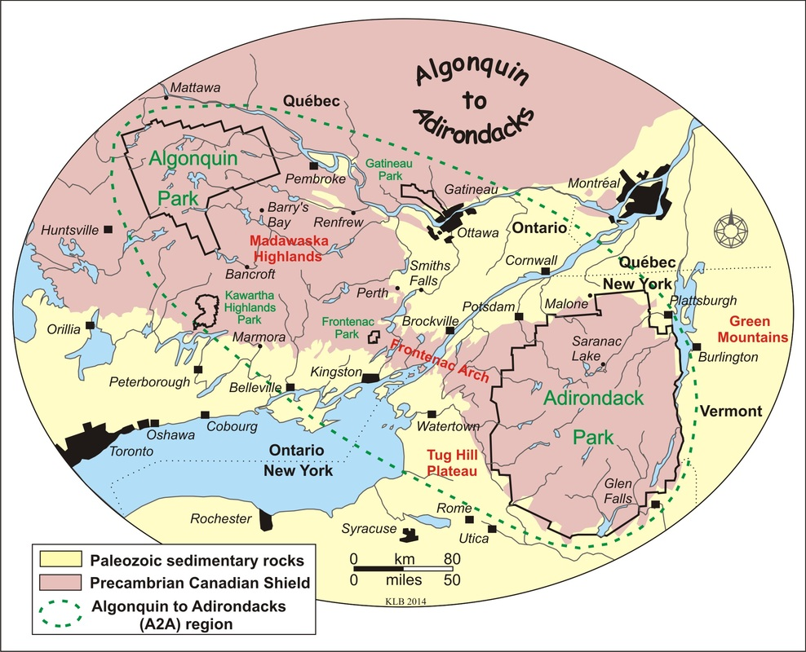
Overview of A2A
Algonquin to Adirondacks Collaborative

Slide 5
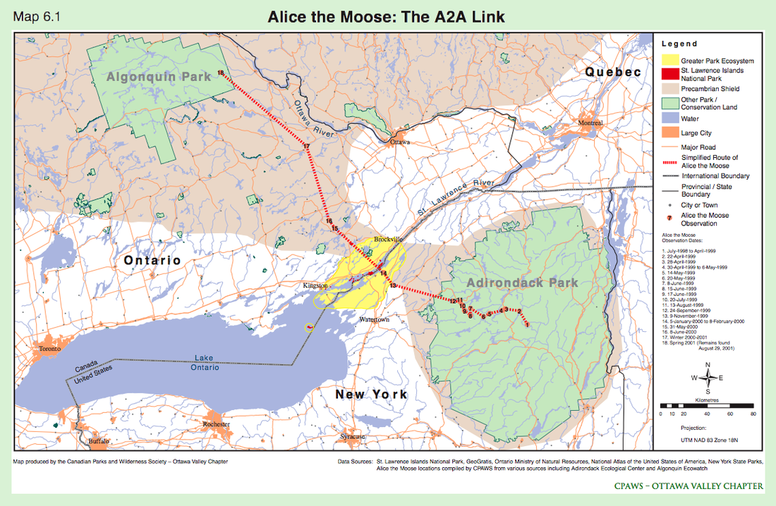
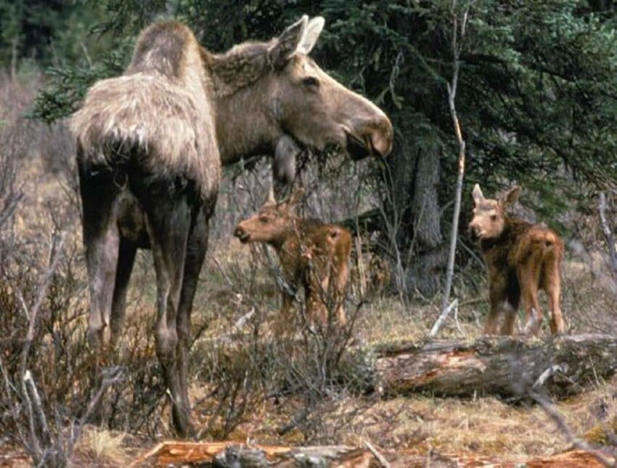
Overview of A2A
Algonquin to Adirondacks Collaborative

Slide 6
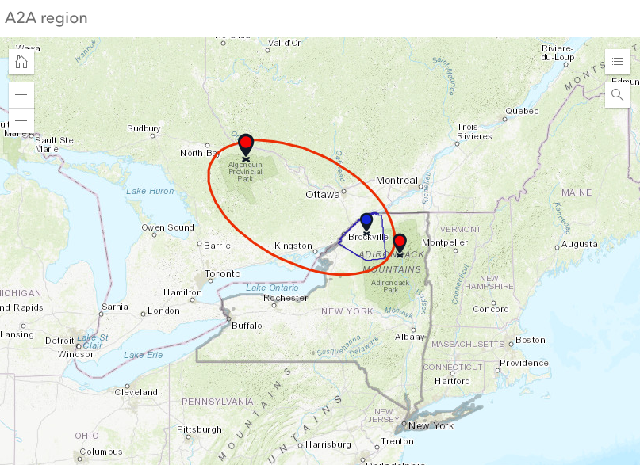
Overview of A2A

Slide 7
Citizen Science Project sponsored by Nature Up North
Goals:
  Collect important data to:
    Further our understanding of the diversity/abundance/needs of wildlife in our region
    help in development of the A2A project
  Further the aims of the Nature Up North project
    (re)connect NoCo residents with the natural world
    Build a bioregionally literate citizenry
  Provide an avenue for locally-focused STEM education in K12 schools, youth organizations

Slide 8
North Country Wild
The Big Questions:
What is the diversity and abundance of (mostly mammalian) wildlife species in St. Lawrence County?
Where is the best wildlife corridor in the A2A region?
How do wildlife use habitat between the Adirondack State Park in NY and Algonquin Provincial Park in Ontario?
  What is the diversity of mammal species across habitat types?
  Are all habitat types used equally?
  Which habitats might form the best wildlife corridor?

Slide 9
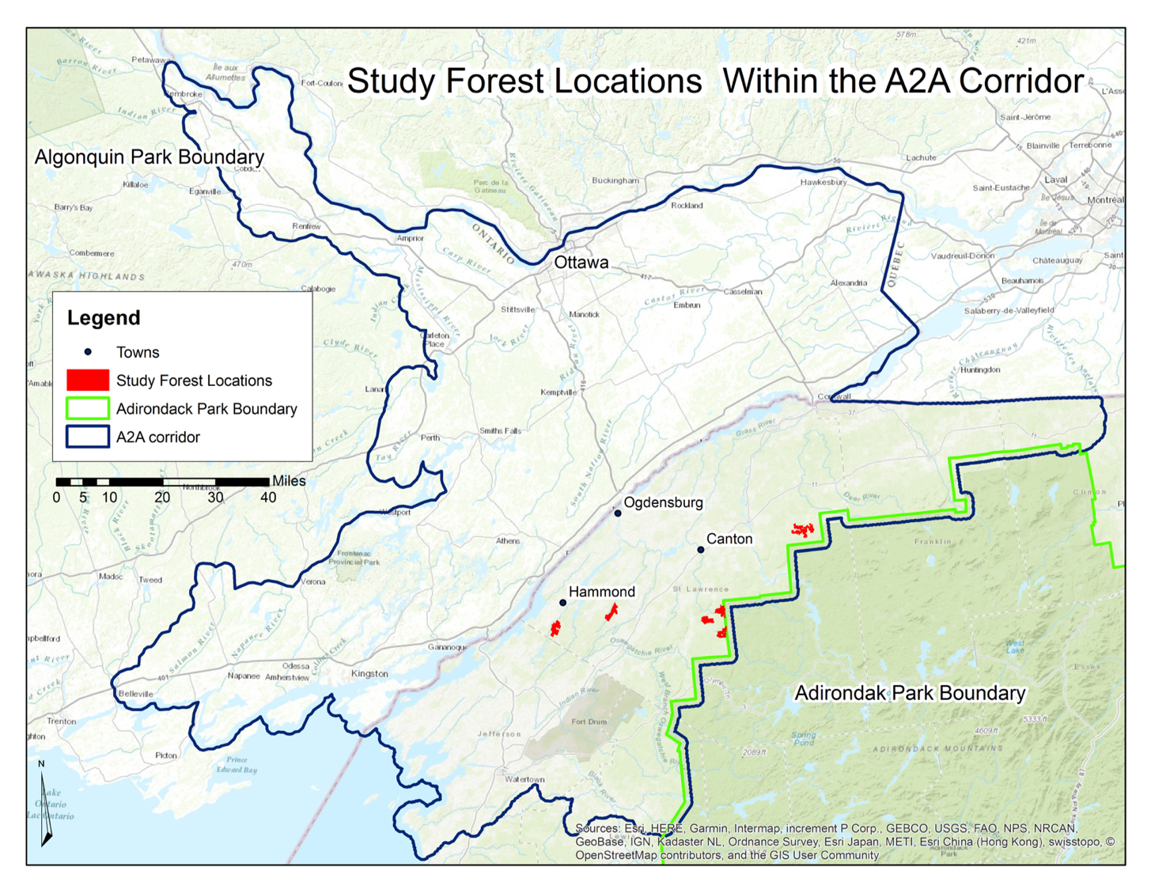

Slide 10
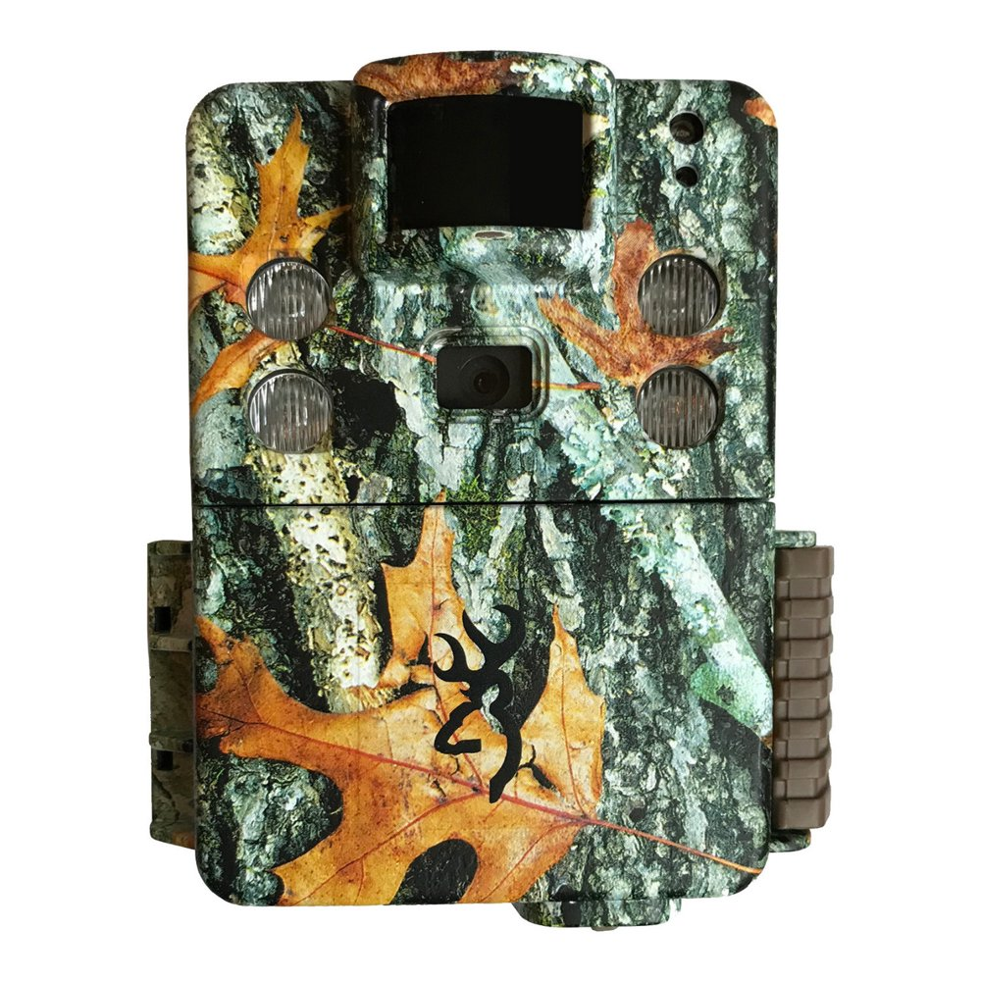
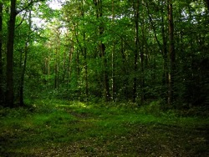
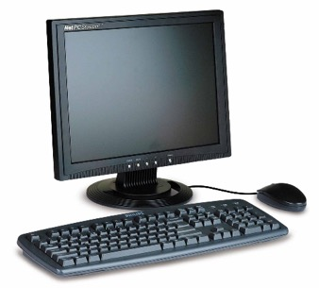


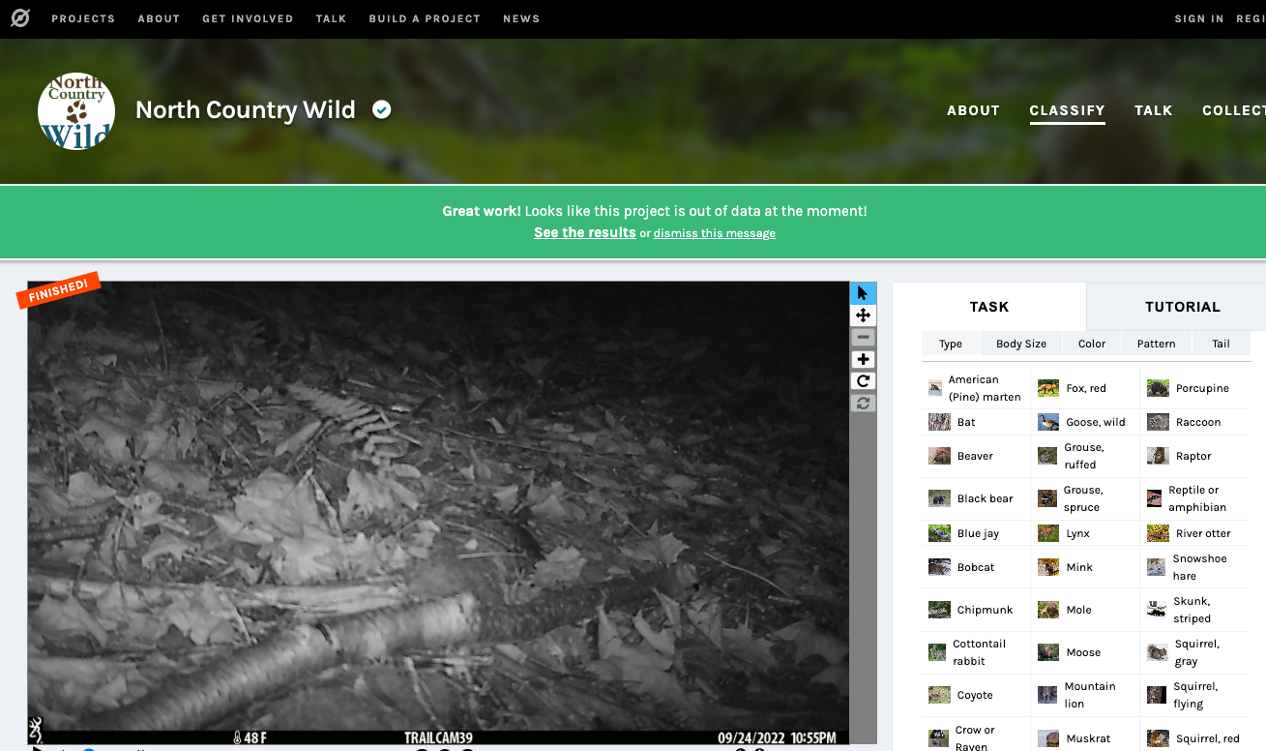
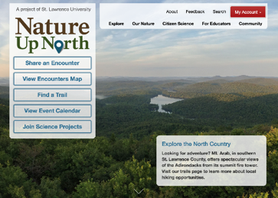
North Country Wild Workflow
1. Formulate hypotheses
2. Set up game cameras
3. Deploy cameras in field for assigned time
4. Pull cameras, upload pictures to NUN Dropbox
5. NUN uploads pictures to Zooniverse (cloud)
6. ID species in images on Zooniverse
7. Results posted on Nature Up North website
8. Evaluate hypotheses

Slide 11
Camera Deployment
FILL OUT ALL FIELDS ON DATA SHEET at deployment and retrieval
Deployment reminders:
  Cam facing North
  Check date and time correct
  Camera parallel with ground
  Camera 0.5 m above ground
  Scale bar deployed
  Camera is ON
  Walk in front of camera during deployment
Retrieval reminders:
  Walk in front of camera before powering down
  Is camera working? Add info to NOTES
  Confirm retrieval date and time on data sheet

Slide 12
Data Upload
TBD!

